Slide 1



FINTECH: REVOLUTIONIZING FINANCIAL SERVICES VIA DESIGN AND TECHNOLOGY
Data and Business Analytics
SE SSI O N S 1
Fintech 101 - Course Openning
Manoel Gadi
Fall 2021

Slide 2


COURSE OBJECTIVES
Explore how Fintech are reshaping the banking and payments industry,
How Fintech are using technology to improve user experience focused on unbundling and untangling financial services,
Demystify blockchain and cryptocurrency from a technological and investment standing point,
Build a "Minimun Viable Fintech" and thus face the design dilemmas of the solution that a Fintech faces on a daily basis regarding design, user experience and technology,
Finally, explore the future of Fintechs.

Slide 3
1) What is FinTech?
Notes:
What is FinTech?
FinTech – a contraction of “finance” and “technology” is the use of technology in the financial services industry resulting in the introduction of new and innovative products and services, primarily through software. At the same time however, FinTech disrupts and challenges the way conventional financial services and products are offered by granting access to untrodden markets through alternative services backed by technology.
FinTech has resulted in the emergence of alternative financing through peer-to-peer lending and merchant financing by electronic marketplace operators to merchants. Other FinTech advances include equity crowdfunding; digital currencies which operate independent of any central authority or banks; payment and remittance systems which bypass traditional banking channels; and the use of big data and analytics to maximise available customer data to further leverage on customer relationships.

Slide 4
What is FinTech?
Payments
Describes the intersection between software and technology to deliver financial services.
May refer to technical innovation applied in a traditional financial services context or to innovative financial services offerings that disrupt the existing financial services market.
Financing
Investments
FinTech
Big Data
Advisory
Insurance
Notes:
What is FinTech?
FinTech – a contraction of “finance” and “technology” is the use of technology in the financial services industry resulting in the introduction of new and innovative products and services, primarily through software. At the same time however, FinTech disrupts and challenges the way conventional financial services and products are offered by granting access to untrodden markets through alternative services backed by technology.
FinTech has resulted in the emergence of alternative financing through peer-to-peer lending and merchant financing by electronic marketplace operators to merchants. Other FinTech advances include equity crowdfunding; digital currencies which operate independent of any central authority or banks; payment and remittance systems which bypass traditional banking channels; and the use of big data and analytics to maximise available customer data to further leverage on customer relationships.

Slide 5
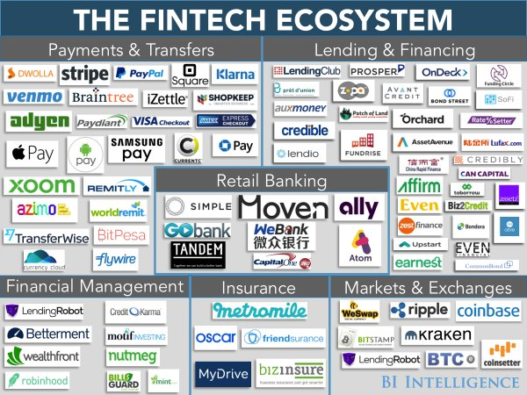

Slide 6
2) A real case
Notes:
What is FinTech?
FinTech – a contraction of “finance” and “technology” is the use of technology in the financial services industry resulting in the introduction of new and innovative products and services, primarily through software. At the same time however, FinTech disrupts and challenges the way conventional financial services and products are offered by granting access to untrodden markets through alternative services backed by technology.
FinTech has resulted in the emergence of alternative financing through peer-to-peer lending and merchant financing by electronic marketplace operators to merchants. Other FinTech advances include equity crowdfunding; digital currencies which operate independent of any central authority or banks; payment and remittance systems which bypass traditional banking channels; and the use of big data and analytics to maximise available customer data to further leverage on customer relationships.

Slide 7

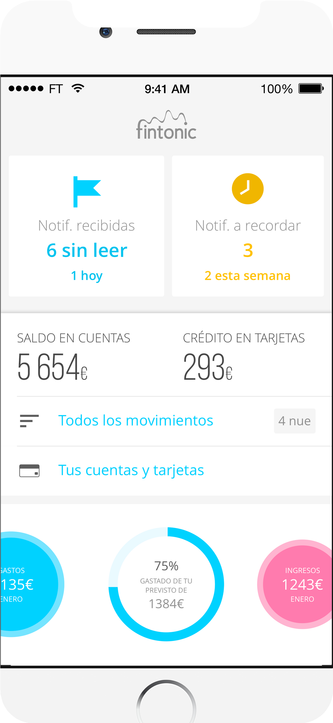
Case: Fintonic
The Fintech that evolves and adapts to our changing world

Slide 8
ORIGIN AND CONCEPT
“I want to create an app that allows users to stop wasting time organising their income and expenses?” Lupina Fintech's Co-Founder
Access users bank's details & extract
relevant insigths
Classify expenses & credit scores using machine learning

Slide 9
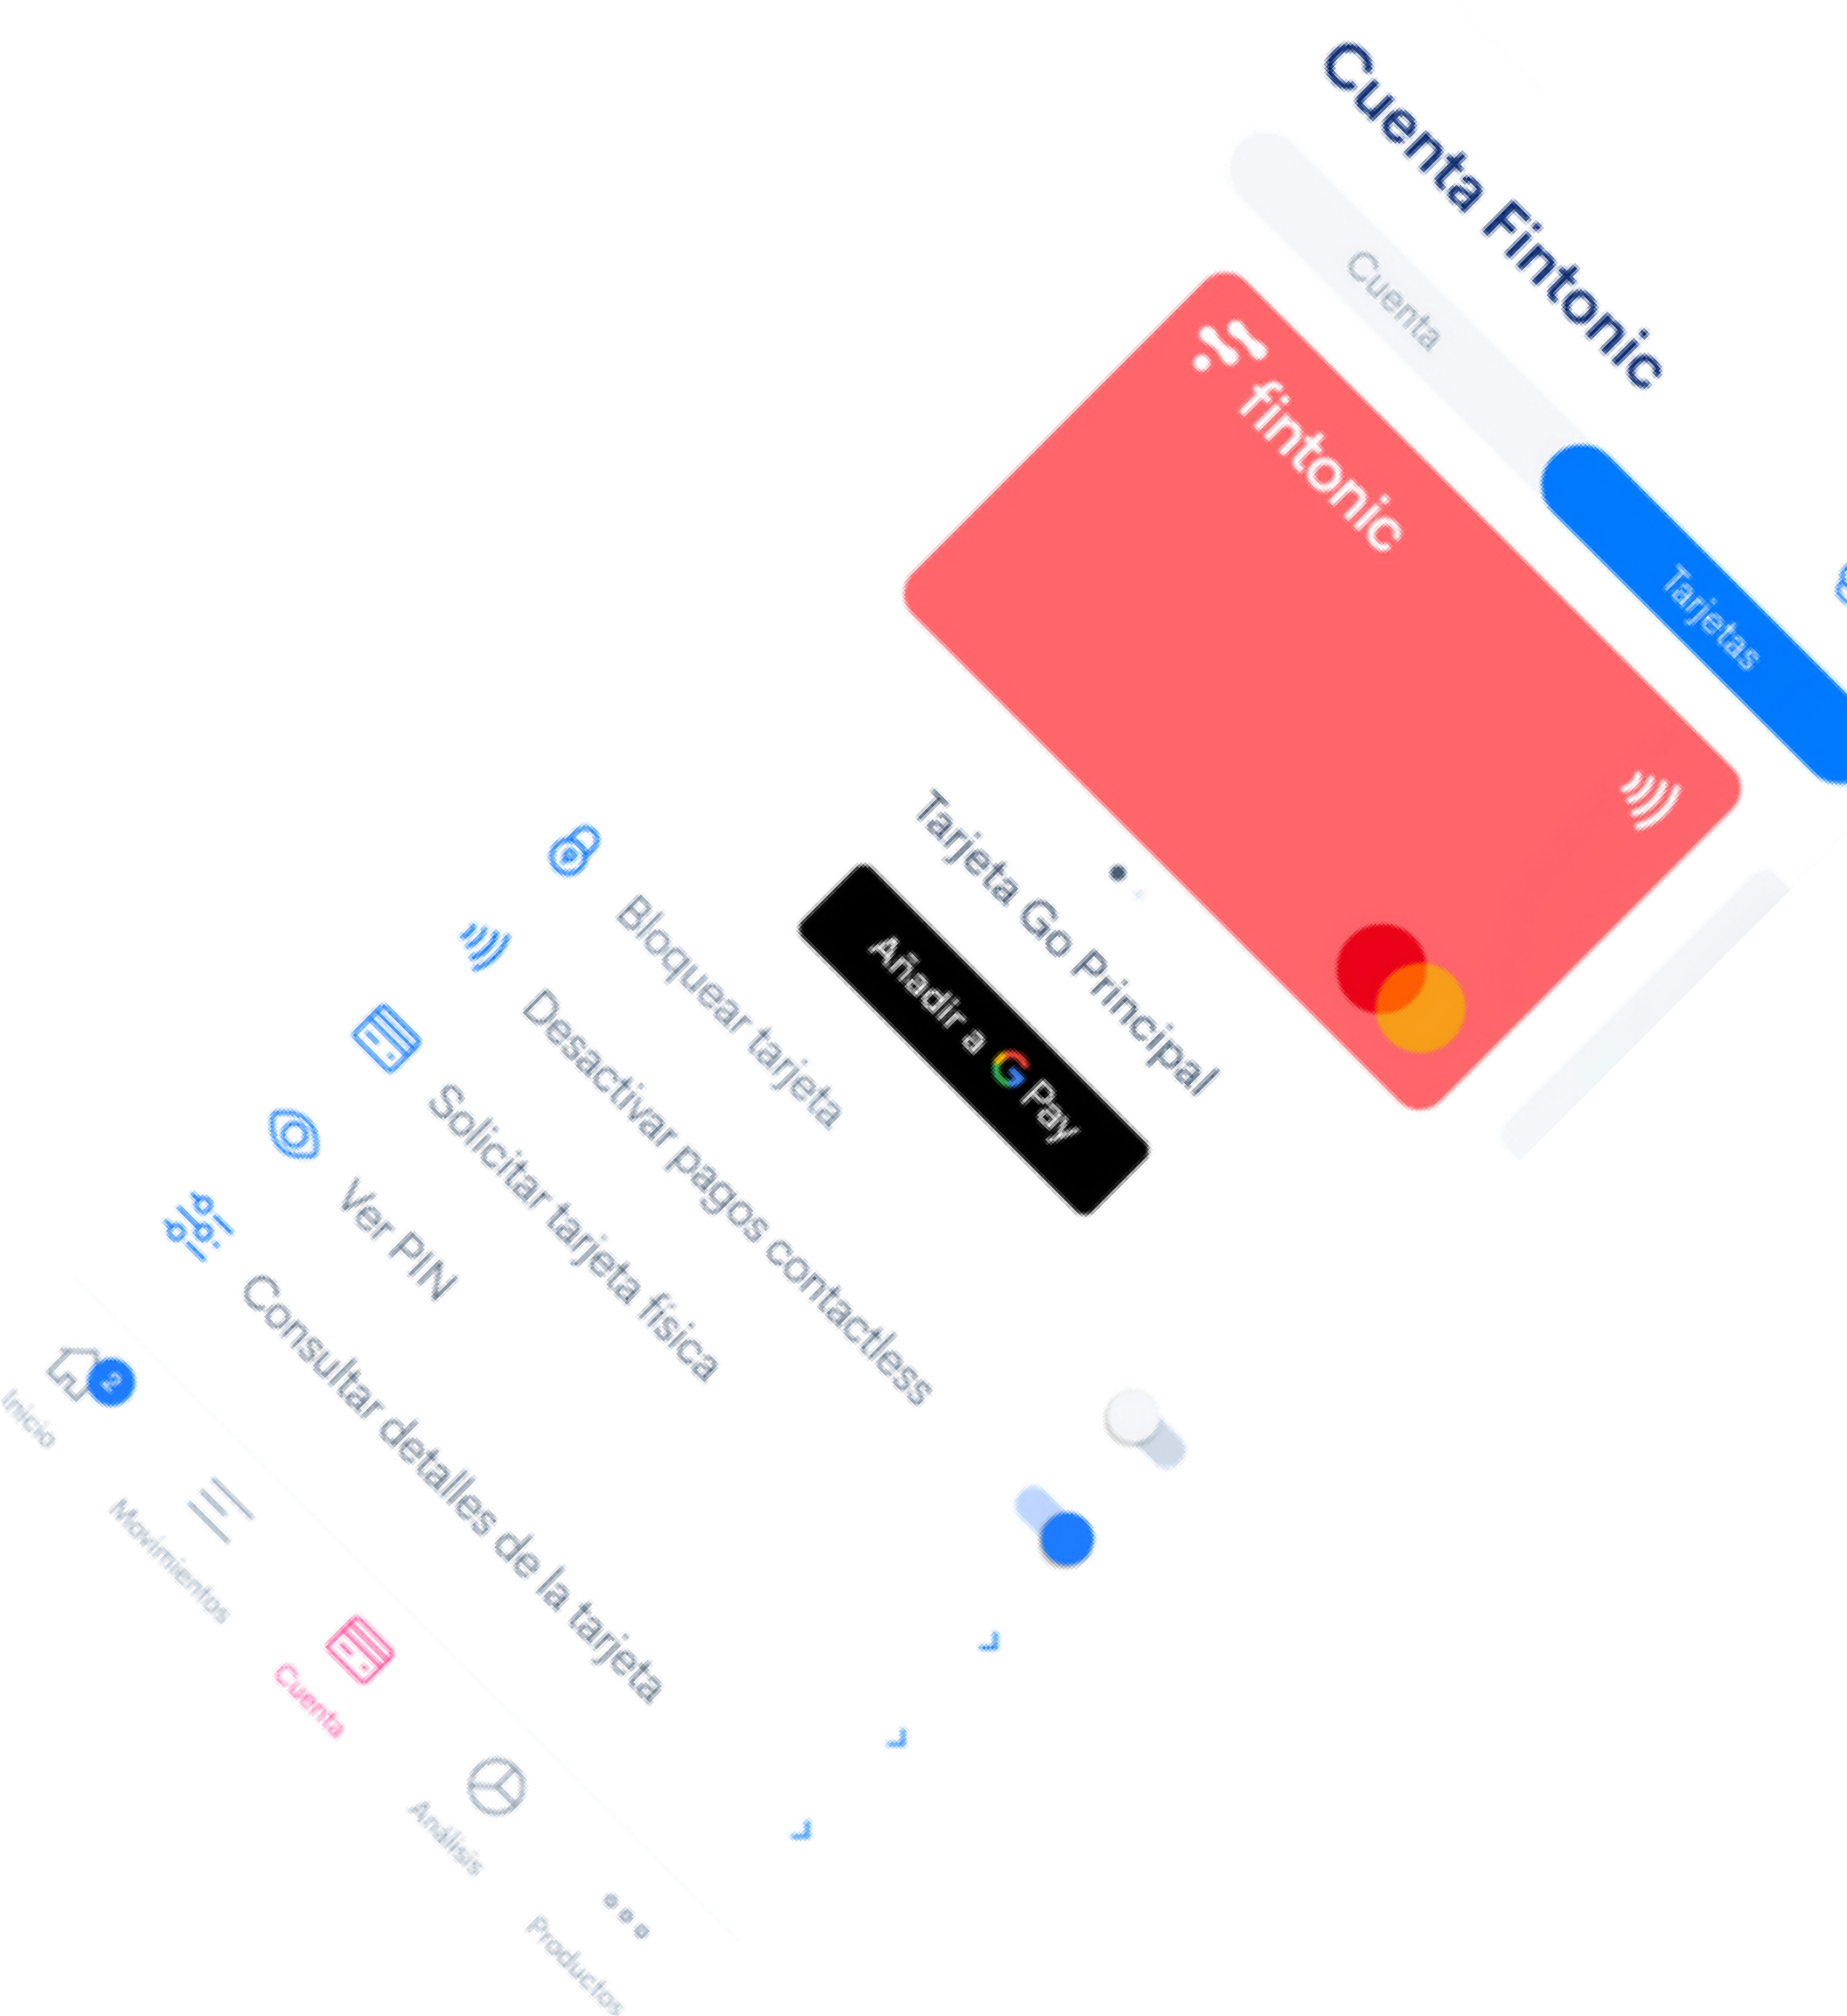


FINTONIC TODAY
“I want to create an app that allows users to stop wasting time organising their income and expenses?”
+700K active users
More than 135 employees Education module
Credit manager Insurance comparator Risk default evaluator

Slide 10
CURRENT MARKET SEGMENT
Ultra Fans
All services in the app
User information downloaded after user consents
Heavy Users
Key component → High quality and extensive database
Two ways to engage users:
Controllers
Free wallet card
Educational videos
Occasional Users

Slide 11



FINTONIC CURRENT MODEL
TRANSACTIONS INFO
MODEL CLASSIFICATION
REFERENCE
TRANSACTION TYPE
DESCRIPTION
QUANTITY
COMMERCE/BRAND
DATE

Slide 12

Leveraging our expertise to increase our offering
Fintonic wil now offer companies risk prediction
Greater Margins (More revenue generated by B2B) Less customers needed
Clearer objectives

Slide 13
MAIN CHALLENGES
Quantifying the creditworthiness of a borrower is a challenging task:
SUBJECTIVE
EXTERNAL FACTORS
NEW RISKS
Very subjective, each company score depends on various factors (industry, country…) Need a mix of quantitative and qualitative analysis .
Assessing a customers risk should be done with more than customers historical data, financial metrics should be taken I not a consideration.
New risks are emerging in our society making credit rating a very challenging task. The outbreak of the pandemic or environmental changes make credit scores highly umpredictable

Slide 14
SOLUTION
Technology
Leveraging Machine Learning to predict companies’ risk.
Diversity
A model capturing the subtleties of different companies.
Reliability
Incorporating relevant financial ratios to reach an accuracy of 93.22%
Credit Rating needs to evolve and adapt to our changing world. It needs to use more than customers historical data to predict risk.

Slide 15

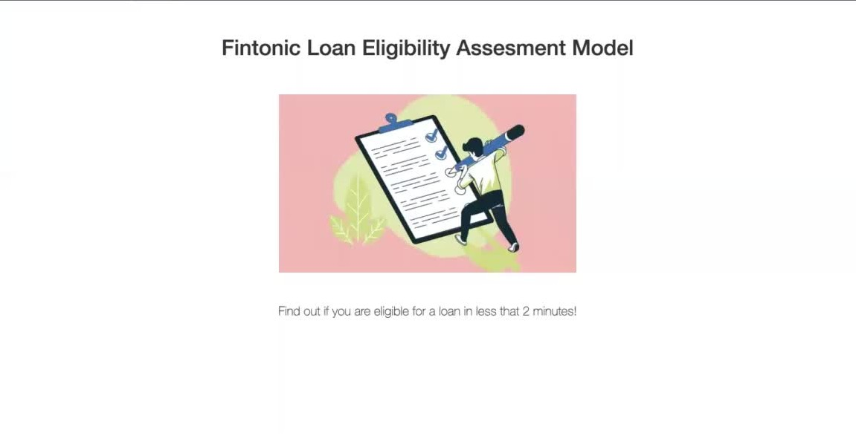

Slide 16


FUTURE IMPROVEMENTS
Fintonic is committed to evolve and adapt to our changing world
Financial Metrics
Customers' Data
Building models based on various data to offer the most accurate credit ratings.
1
Build alliance networks to capitalise on specific expertise to predict risk – ex: Greentech to assess environmental risk factors
2
ML key to building these new types of models - to build models using huge amounts of different data
3
Emerging Risks

Slide 17

INVEST IN MORE THAN A FINANCIAL MODEL,
INVEST IN A BETTER
TOMOROW.

Slide 18

KAHOOT
Notes:
What is FinTech?
FinTech – a contraction of “finance” and “technology” is the use of technology in the financial services industry resulting in the introduction of new and innovative products and services, primarily through software. At the same time however, FinTech disrupts and challenges the way conventional financial services and products are offered by granting access to untrodden markets through alternative services backed by technology.
FinTech has resulted in the emergence of alternative financing through peer-to-peer lending and merchant financing by electronic marketplace operators to merchants. Other FinTech advances include equity crowdfunding; digital currencies which operate independent of any central authority or banks; payment and remittance systems which bypass traditional banking channels; and the use of big data and analytics to maximise available customer data to further leverage on customer relationships.

Slide 19
3) The Fintech Market
Notes:
What is FinTech?
FinTech – a contraction of “finance” and “technology” is the use of technology in the financial services industry resulting in the introduction of new and innovative products and services, primarily through software. At the same time however, FinTech disrupts and challenges the way conventional financial services and products are offered by granting access to untrodden markets through alternative services backed by technology.
FinTech has resulted in the emergence of alternative financing through peer-to-peer lending and merchant financing by electronic marketplace operators to merchants. Other FinTech advances include equity crowdfunding; digital currencies which operate independent of any central authority or banks; payment and remittance systems which bypass traditional banking channels; and the use of big data and analytics to maximise available customer data to further leverage on customer relationships.

Slide 20
Where Fintechs are (EY study)
Place | Market Size | Investment | Fintech staff | Characteristics
NYC | 7.5bn | 1.9bn | 57,000 | close to markets 1st generation incubators & accelerators
California | 6.3bn | 4.8bn | 74,000 | mature FinTech community established connections large VC funds
UK | 8.9bn | 707m | 61,000 | global financial hub progressive government & reg. effective network of hubs
Germany | 2.4bn | 524m | 13,000 | mostly credit & lending increasing focus on b2b complex startup environment
Hong Kong | 0.9bn | 62m | 8,000 | relatively nascent market community focused on capital markets
Singapore | 0.9bn | 50m | 7,000 | gateway to Asia easy to do business, English dedicated team at regulator
Australia | 0.8bn | 267m | 10,000 | emerging Fintech ecosystem 0.9bn commitment to innovation

Slide 21


Examples of FinTech
Peer to peer or marketplace lending platforms
lending to individuals or businesses through online services that match lenders directly with borrowers
operation of lending platform may be regulated
Equity crowdfunding
funding a project or venture by raising money from a large number of people
may be regulated for arranging securities transactions or operating an unregulated investment fund
crowdfunder
Roboadvice
automated financial advice (computer based algorithms and decision trees)
may be subject to adviser registration/regulation

Slide 22


Examples of FinTech
Virtual currencies
Bitcoin etc. might constitute currencies if the trading in them is regulated; also raises AML issues
On-line payment accounts
accounts through which you can send money, make payments online, and receive money
may be regulated as non-bank payment institutions
Payment initiation services
service used to initiate a payment to another party

Slide 23
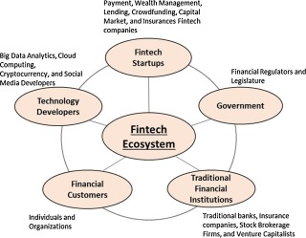
Five elements of the Fintech Ecosystem

Slide 24
4) Why Fintech?
Notes:
What is FinTech?
FinTech – a contraction of “finance” and “technology” is the use of technology in the financial services industry resulting in the introduction of new and innovative products and services, primarily through software. At the same time however, FinTech disrupts and challenges the way conventional financial services and products are offered by granting access to untrodden markets through alternative services backed by technology.
FinTech has resulted in the emergence of alternative financing through peer-to-peer lending and merchant financing by electronic marketplace operators to merchants. Other FinTech advances include equity crowdfunding; digital currencies which operate independent of any central authority or banks; payment and remittance systems which bypass traditional banking channels; and the use of big data and analytics to maximise available customer data to further leverage on customer relationships.

Slide 25

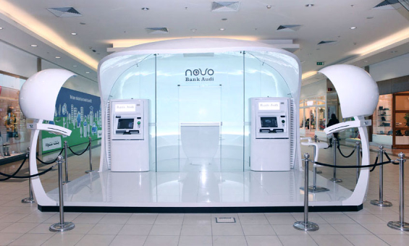



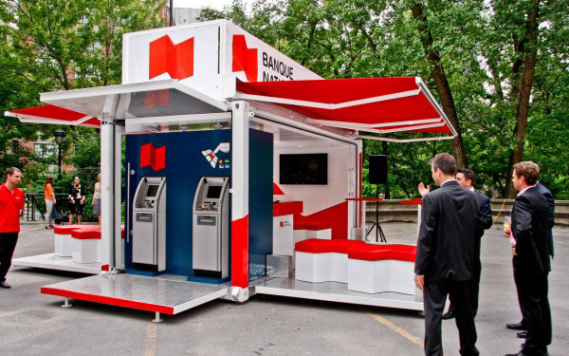
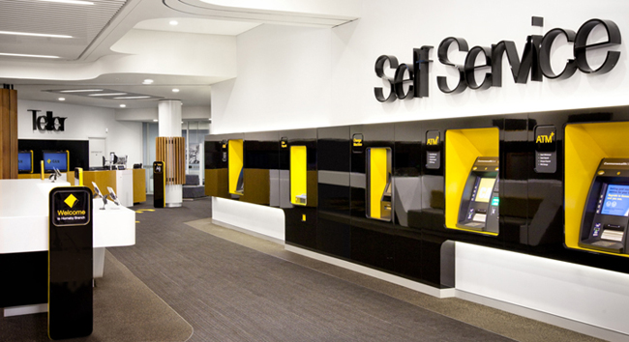
Banks … adapt … or … die
branch stall
mobile branch
drive thru
pop-up portable branch
Hyper connected branch

Slide 26


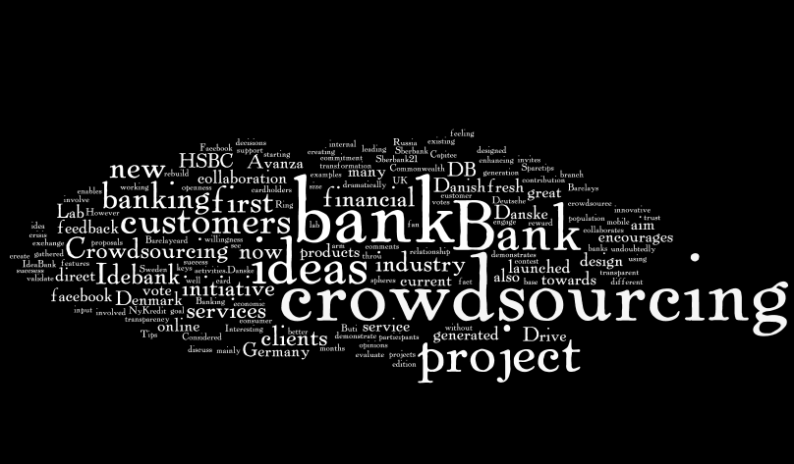



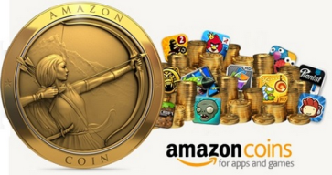
New paradigms
Augmented Reality

Slide 27
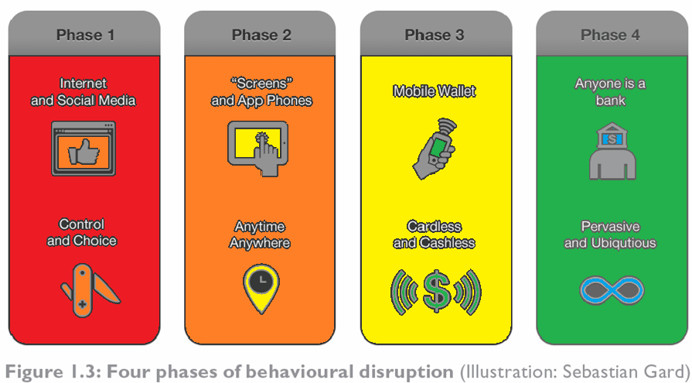
- On Card Business … change is the new status-quo.

Slide 28
Growth of FinTech
Statistics:
Forcasted that over $4.7 trillion of revenue at traditional financial services companies is at risk of disruption by FinTech companies
FinTech firms attracted $19 billion in investment in 2015
FinTech has emerged due to: technology (social networks, big data) favorable regulatory environment demographics (rise of the millenials) mobile financial services provide cheap banking solutions to the unbanked

Slide 29
Growth of FinTech
Statistics:
Forcasted that over $4.7 trillion of revenue at traditional financial services companies is at risk of disruption by FinTech companies
FinTech firms attracted $19 billion in investment in 2015
FinTech has emerged due to: technology (social networks, big data) favorable regulatory environment demographics (rise of the millenials) mobile financial services provide cheap banking solutions to the unbanked

Slide 30
2.1) CREATE / RESPOND / FEEDBACK game - Bank 3.0
Notes:
What is FinTech?
FinTech – a contraction of “finance” and “technology” is the use of technology in the financial services industry resulting in the introduction of new and innovative products and services, primarily through software. At the same time however, FinTech disrupts and challenges the way conventional financial services and products are offered by granting access to untrodden markets through alternative services backed by technology.
FinTech has resulted in the emergence of alternative financing through peer-to-peer lending and merchant financing by electronic marketplace operators to merchants. Other FinTech advances include equity crowdfunding; digital currencies which operate independent of any central authority or banks; payment and remittance systems which bypass traditional banking channels; and the use of big data and analytics to maximise available customer data to further leverage on customer relationships.

Slide 31
FINTECH: REVOLUTIONIZING FINANCIAL SERVICES VIA DESIGN AND TECHNOLOGY
Data and Business Analytics
SE SSI O N S 1
Fintech 101 - Course Openning
Manoel Gadi
Fall 2021

